Slide 1

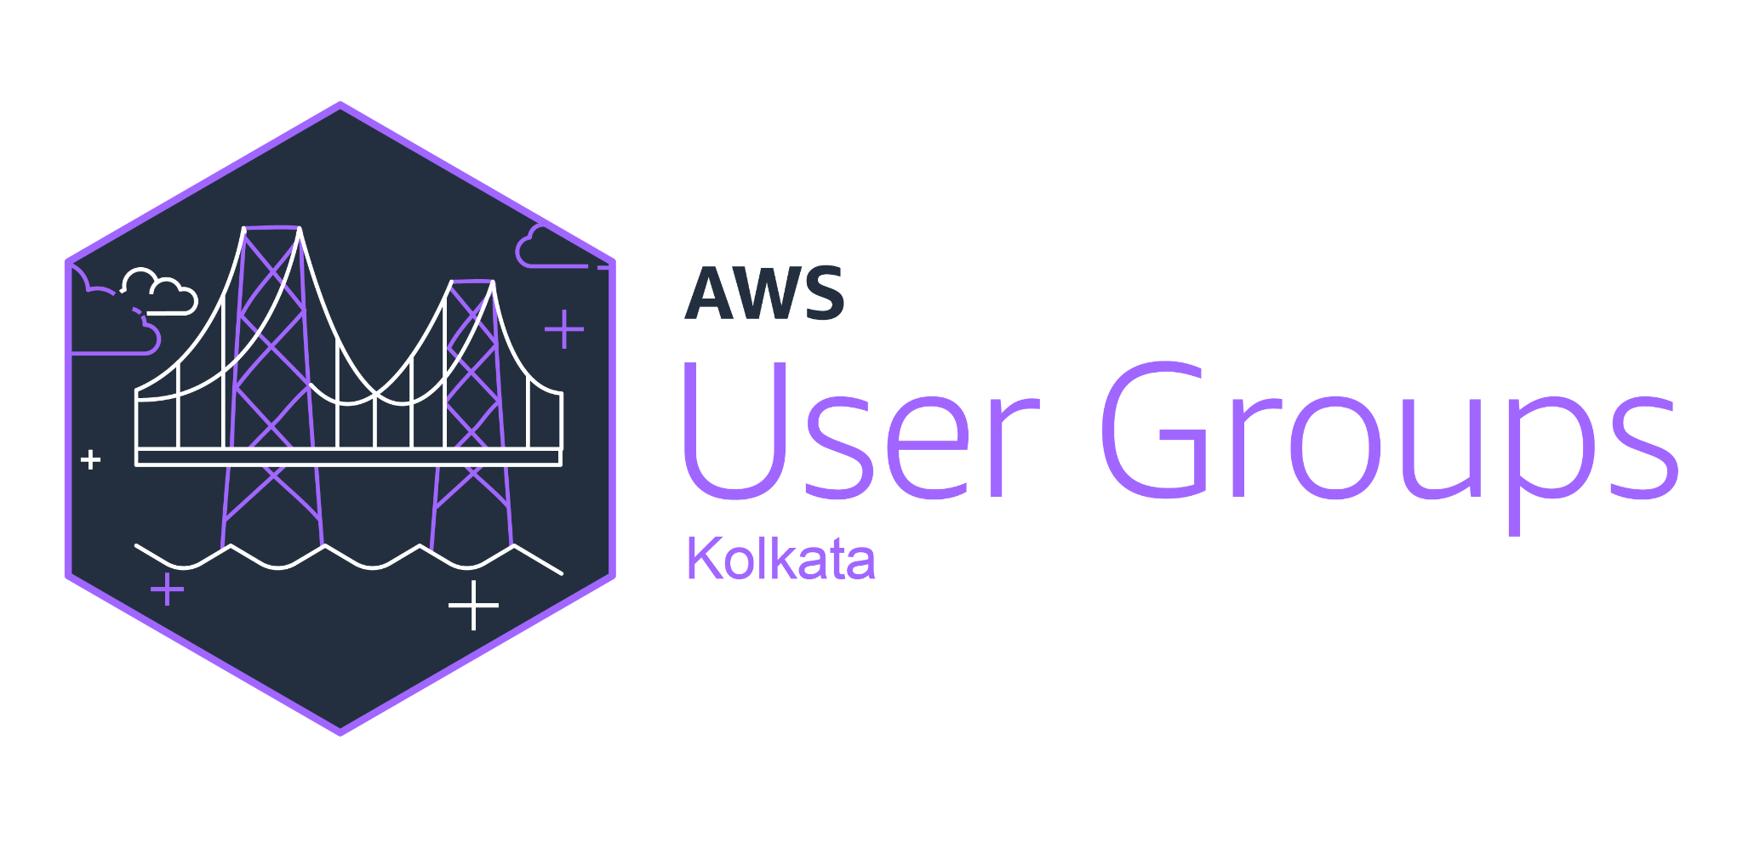

EKS as a Universal Control Plane
- Soumadeep & Anik

Slide 2
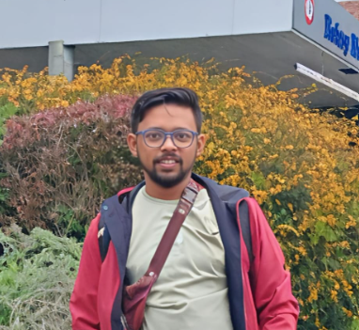
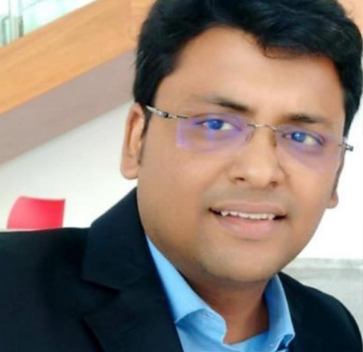

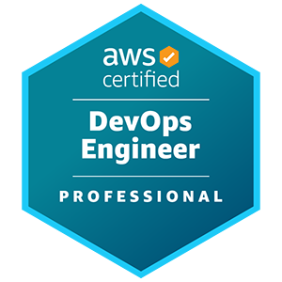


About Us?
Anik Guha, Tech Mahindra
Lead DevOps Engineer with 9+ years of experience, specializing in building containerized solutions.
Soumadeep Bhattacharya, Tech Mahindra.
DevOps Architect with over 14 years of experience, specializing in complex multi-cloud deployments.
https://www.linkedin.com/in/anik-guha/
https://www.linkedin.com/in/soumadeep-bhattacharya-03222021/

Slide 3
Content
World of Platform Engineering
Problem we are trying to solve
How EKS managed Control Planes help
Architecture - Deep Dive
Demo
Sources & References

Slide 4
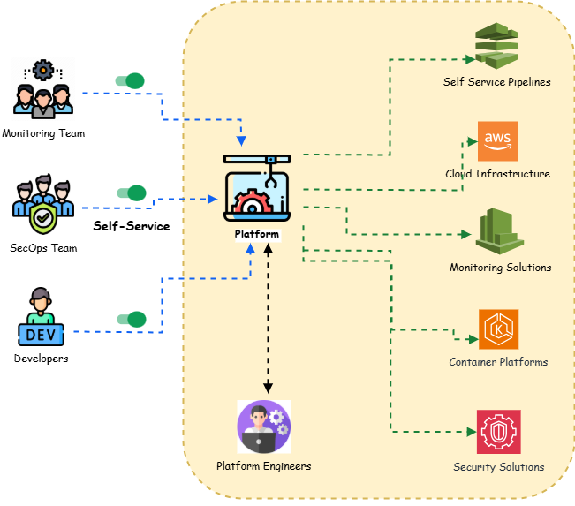
World of Platform Engineering
DRY (Don’t Repeat Yourselves) Principles
Accelerating Dev Teams
Improving Developer Experience
Self Service Consumption
Continuous Improvements

Slide 5
Problem we are trying to solve
Reduce Complexity through Abstraction
Abstracting the underlying complex infrastructure, simplifies the management of distributed systems
Standardize Implementation Pattern
Reduced complexity & building self-service systems -> Improved Go To Market (GTM) timelines
Integration with Existing Tools
Common set of API’s known to developers -> Better Developer Experience (DevEx)
Cross Platform Management
Enables similar pattern for management of resources across multi-cloud, data-center, hybrid-cloud

Slide 6
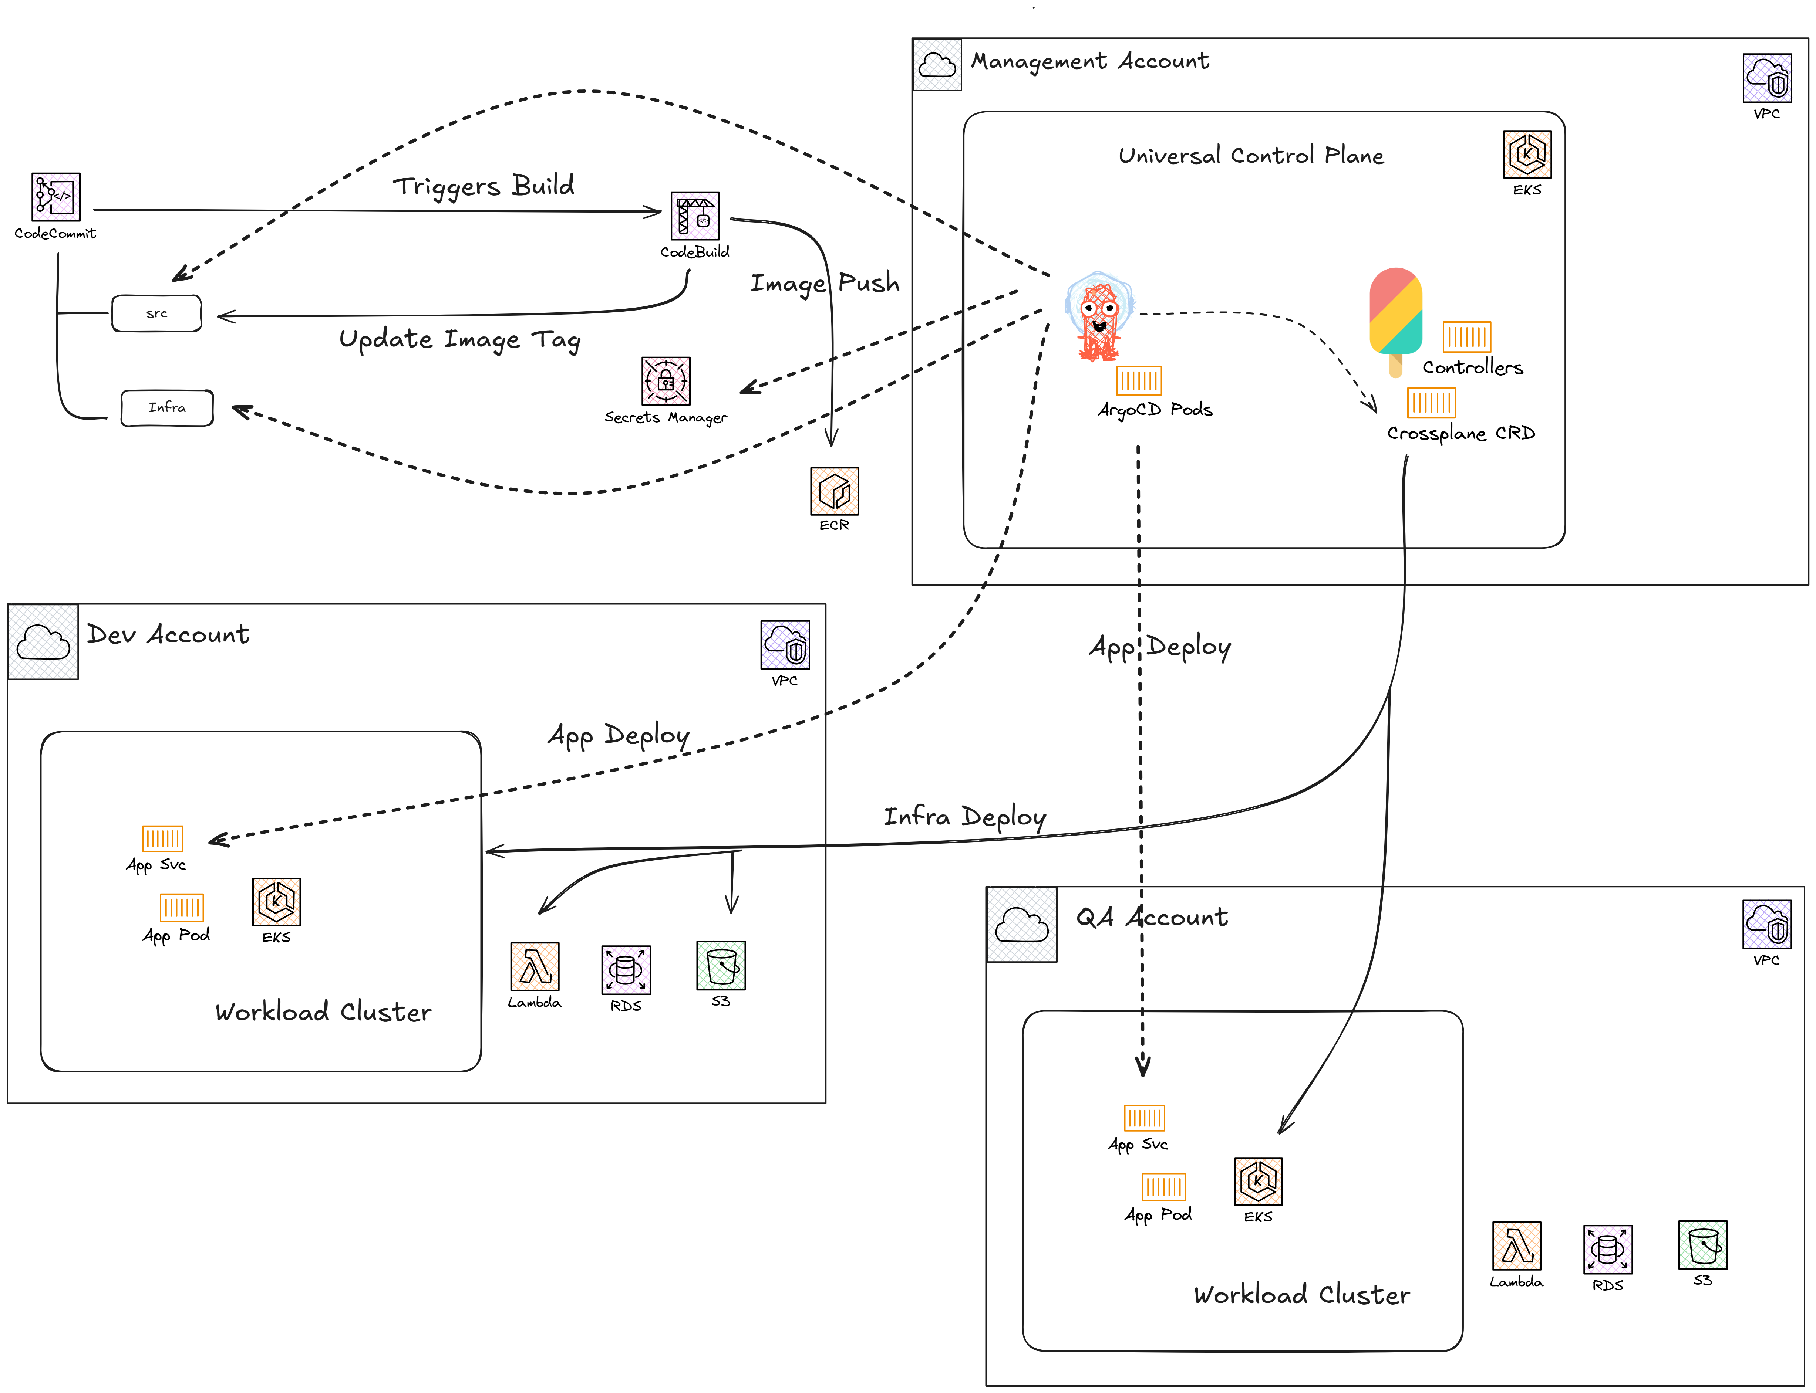
How EKS managed Control Planes help
End Result:
Hassle-free Platform running on AWS EKS.
GitOps based App deployment
GitOps based Infrastructure deployment
Self-service platform management

Slide 7
Deep Dive - Architecture

Slide 8

Time for Demo

Slide 9


Sources & References
Demo Link
Repository Link

Slide 10
Thank You

